Slide 1
Intro to deep learning
For current machine learning practitioners
Daniel Corvesor & Syuria Amiruddin
Data Scientists

Slide 2
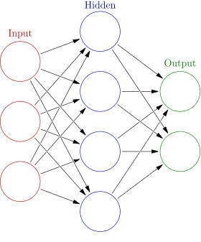
What is a neural network?
"...a computing system made up of a number of simple, highly interconnected processing elements, which process information by their dynamic state response to external inputs.”
Similar to traditional ML, we have a weight matrix representing the network, randomly initialised
We train the network by tuning the weights in this matrix
This is done using gradient descent and an algorithm called backpropagation

Slide 3
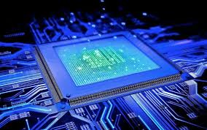
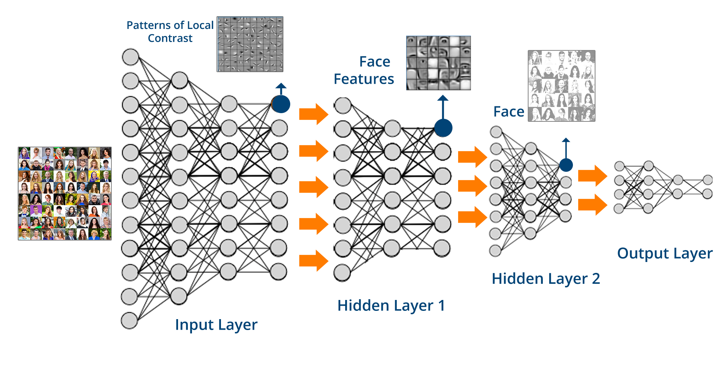
Neural networks existed before – so what’s changed?
Computational power has increased.
The exponential speed up in processing power has meant we can train larger (or deeper) networks.
This is due to GPUs which are excellent for making lots of simultaneous calculations.
This is combined with a plethora of easily accessible data (e.g. ImageNet) which we train these models on.
Without this good quality, labelled data, we would not be able to train these deep networks
Notes:
Better pictures

Slide 4

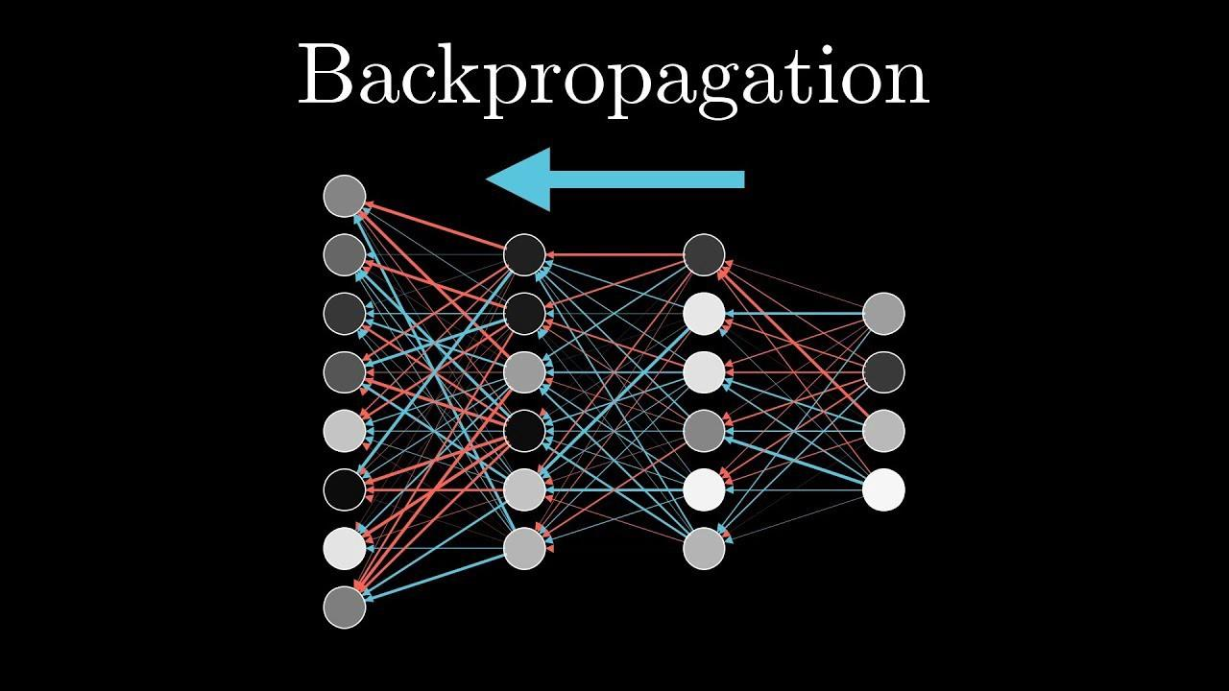
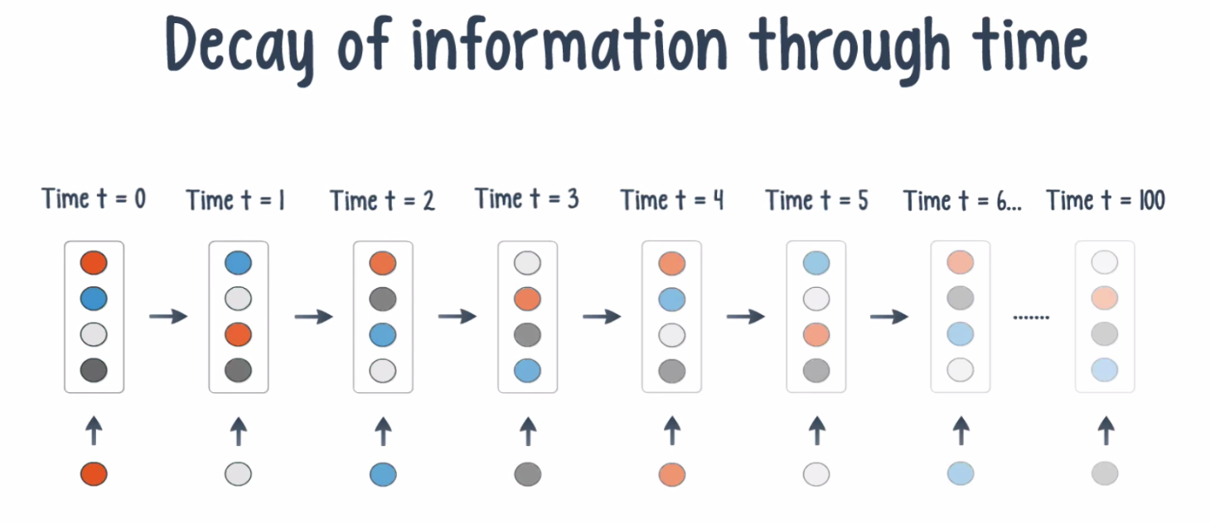
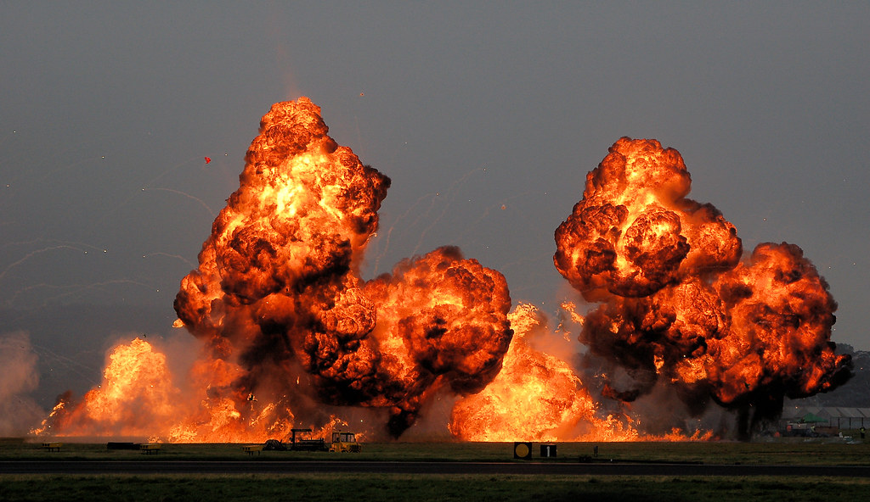

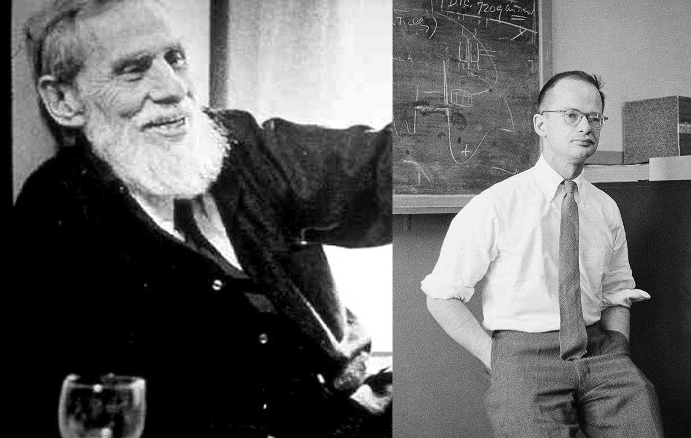
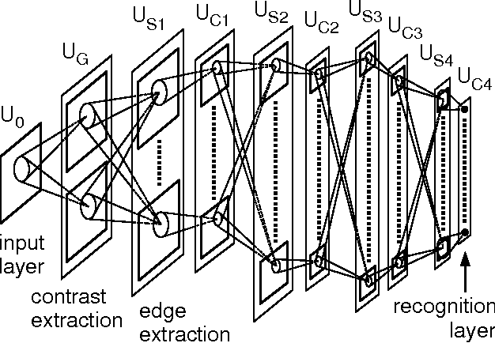
Where did it all start?
ImageNet goes live
2009
2014
VGG-16 wins the ImageNet competition and is released open source
Kelley and Dreyfus come up with the backprop algorithm
2000
The missing/exploding gradient problem is named and identified
1960-62
1980
Fukushima releases Neocognitron, the first CNN
1943
Big increases in the amount of computational power
Pitts and McCulloch develop the first computer model based on neural networks of the brain
Notes:
Keep dots all the size
Keep formatting all the same
Keep text a good size

Slide 5
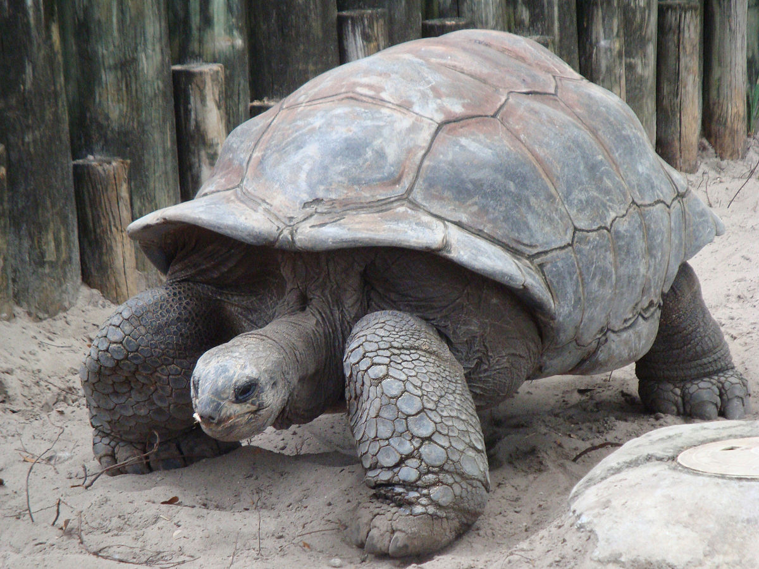
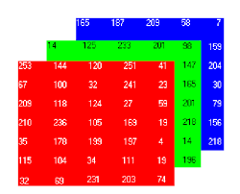
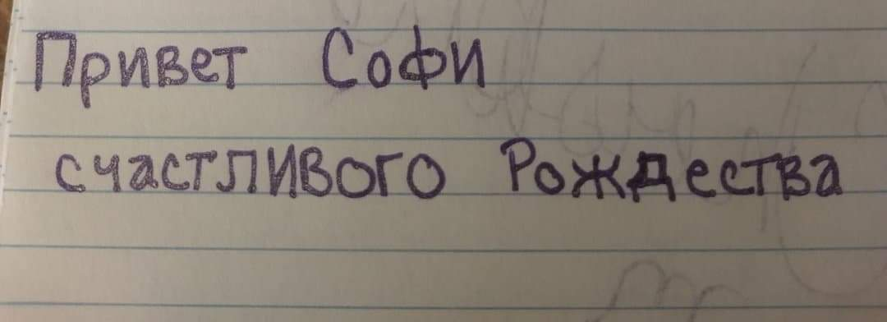
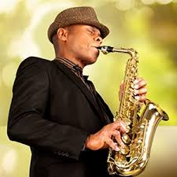
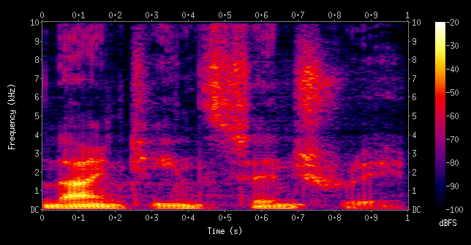
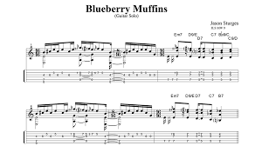
Problems we can solve using DL
Image classification:
Image
RGB pixel values
Classification – it’s a tortoise!
Text translation:
Number values representing words
Foreign text
Text translation – in desired language
Music transcription:
Music recording
Score of the music
Spectogram values
Notes:
Too much going on

Slide 6

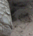
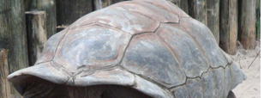



Learning representations
Let’s say we want to again classify this turtle, how can we extract features from these pixels that represent a tortoise?
We can then use these features to learn what a tortoise looks like.
Use these edges to learn what the specific parts of turtle look like
We have ‘learnt’ a representation of what it means for an image to be a tortoise
Learn where the edges in the picture are

Slide 7
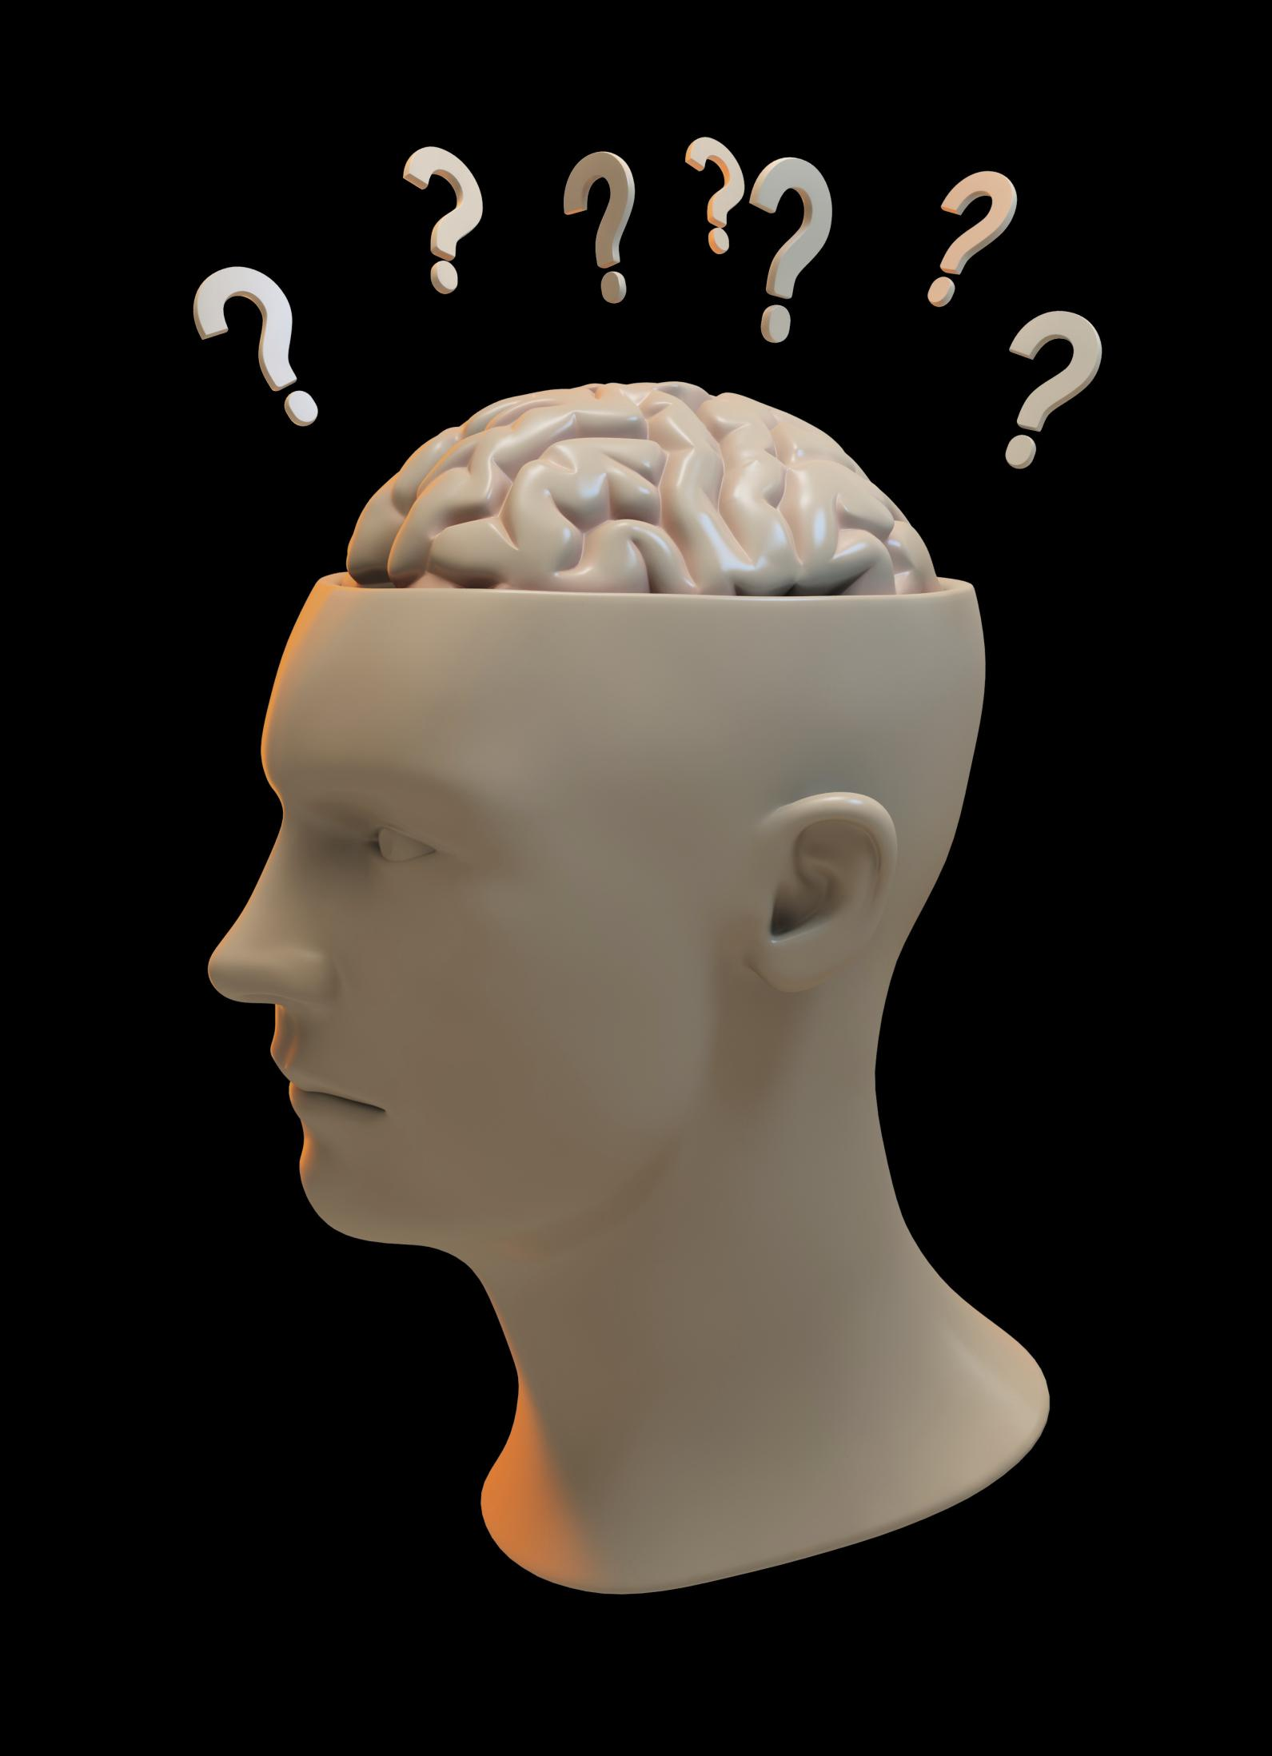
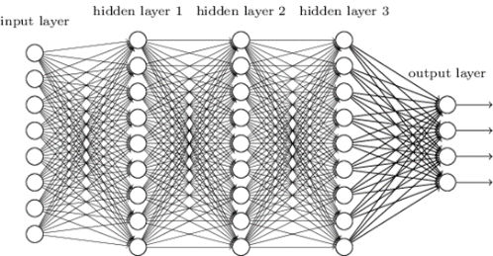
How do we train the model?
1. Forward propagation- get the predictions using our weight matrix
Input Image
Prediction- is it a tortoise?
4. Optimisation – we update our weights and repeat the process
2. Compute loss function – how far are we away from the true answer?
3. Backpropagation – we go back through the network to work out the effect each weight has on the loss function

Slide 8
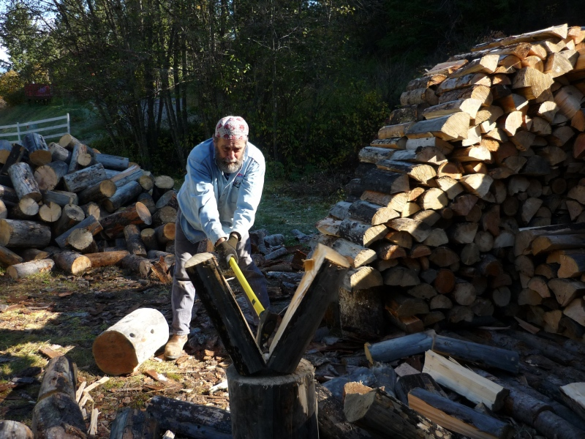
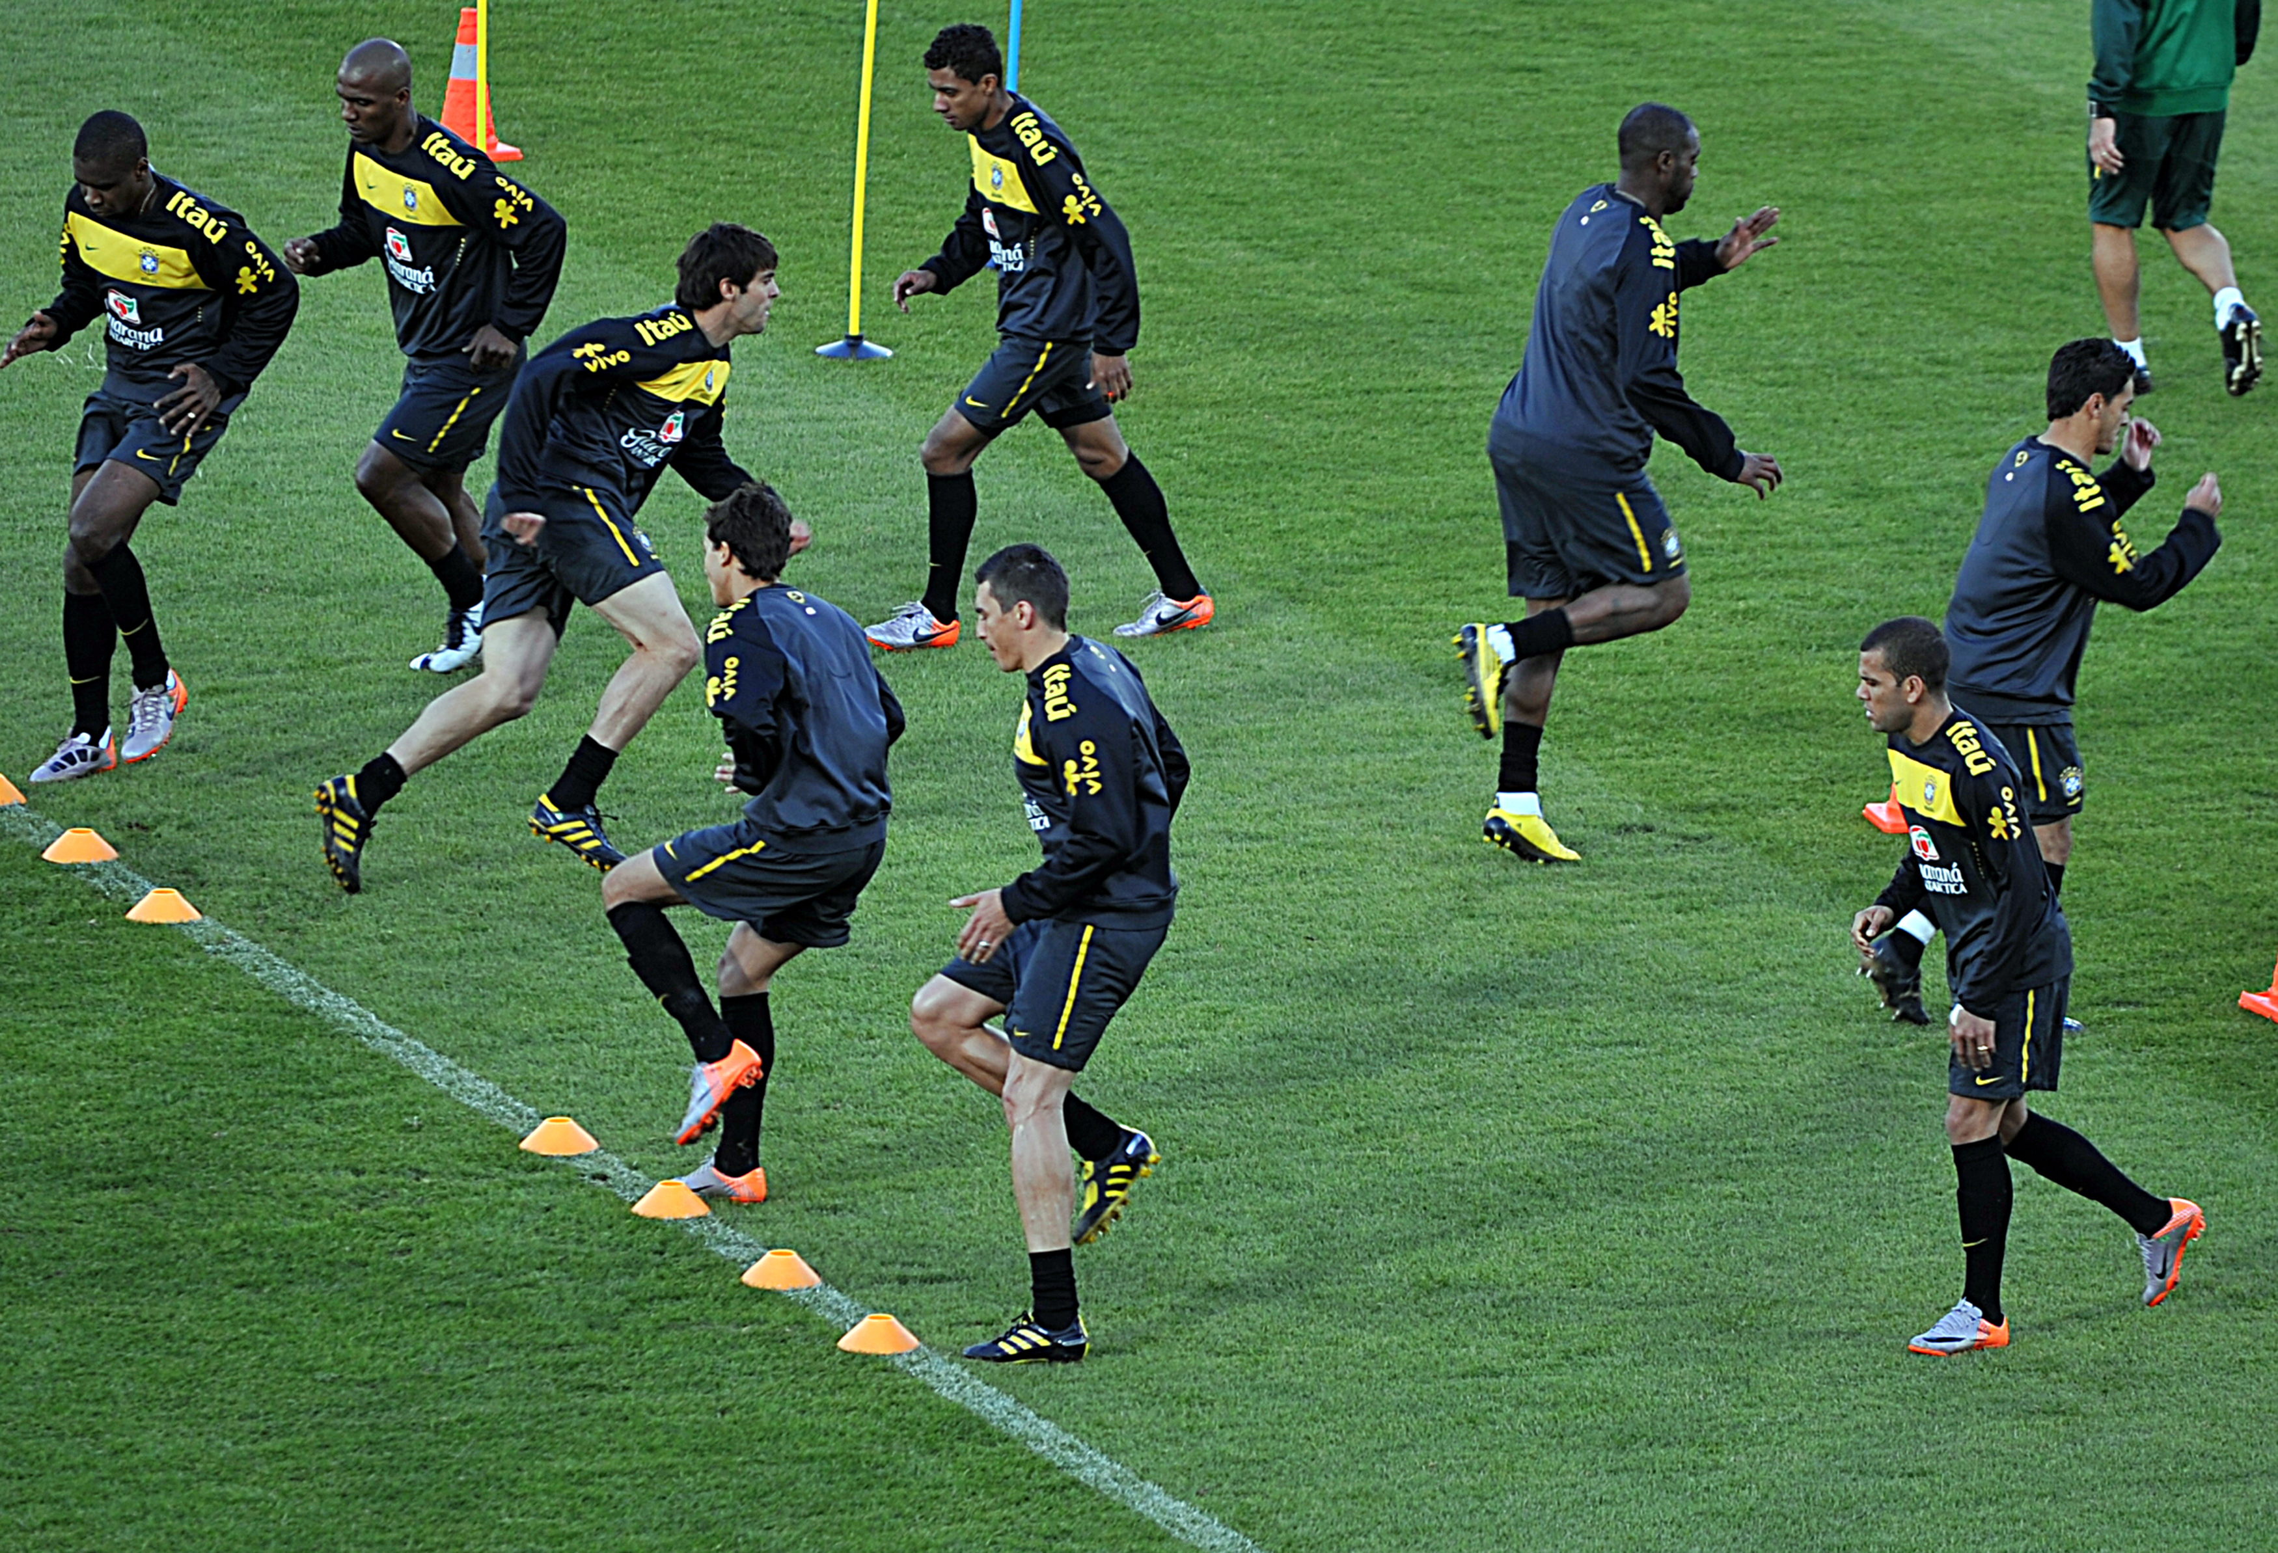
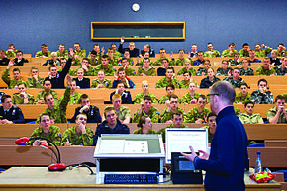
Diving deeper…
Split the data into blocks
We call these blocks ‘minibatches’
We train on each of these blocks
Forward propagation – compute predictions
Optimisation
Update our weights using gradient descent or another learning algorithm
Compute loss function – how well are we doing?
Back propagation – compute derivatives
This Photo by Unknown Author is licensed under CC BY-SA-NC

Slide 9

Gradient Descent – a reminder
We can imagine the cost/loss function as the ‘upward’ direction on a mountain range.
When we compute derivatives, we are working out the steepness of the hill in all directions from where we are now.
Then we can take one small step in the steepest direction to hopefully decrease the cost function (get to the lowest point)!
Cost/loss function
X₁
X₂
Two of our weights

Slide 10
Forward propagation
z = Wa+ b
1
This is the way in which we go from an input to an output.
For each layer we compute the new nodes by multiplying by the weight matrix first and then apply the activation function.
These are the inputs to the next layer.
Bias term
Intermediate term
The weight matrix for that layer
The output from the previous layer
2
a = f(z)
f is the activation function, whatever you have chosen
This will be passed to the next layer
Notes:
In the formula, drop some indices drop all the numbers, just vectorise it

Slide 11

Backpropagation – the mystery behind the magic
Traditional:
Deep Learning:
We compute dJ(θ)∕dθ_{1,} dJ(θ)∕dθ₂, ..., dJ(θ)∕dθ_{n ,} - derivatives of the cost function with respect to the weights (the steepness of the hill in every direction!)
NNs are no different. It’s a little harder to do as the inputs are operated on so many times before they get to the output.
We use the beauty of the chain rule (remember that?) to calculate the same thing.
Starting with the penultimate layer, we calculate the derivative for the weights and bias for this layer.
Iteratively, we can find the derivative of all the other bias and weight terms.

Slide 12
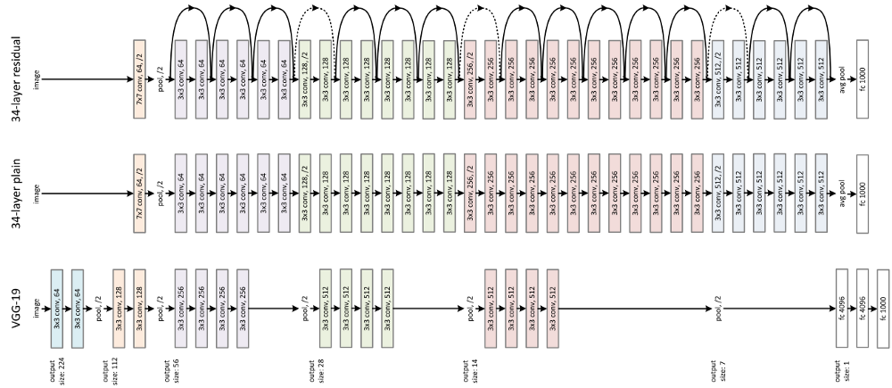
Advanced concepts
Different architectures:
Fully connected:
ResNet, VGG16 and CNNs CNNsd
CNNs
Overfitting – as with ML we can regularise:
Add a regularisation term
Implement dropout
Batch normalisation (mainly to learn quicker)
Optimiser
ADAM
Learning rate decay

Slide 13
Libraries
Heaps of detail but are there any tools to help us?
Yes! We have:
Tensorflow by Google
Keras – very high level specific to NNs
Pytorch by Facebook
And others…
A lot of the key algorithms and functionalities we have spoken about are pre programmed in these libraries.

Slide 14

Pytorch – demonstration coming up!
A highly optimised library with full support for Deep Learning from Facebook
Has a number of very useful features including CUDA for GPU support and functions for initialising and training networks
We will be using a library built on top of Pytorch, called Pytorch Lightining to simplify some of the operations
Let’s have a go now!

Slide 15


Your first deep learning model
We will train our model to differentiate between pictures of handwritten digits ranging from 0-9
We will use a famous dataset called the MNIST dataset
Our images have quite low resolution so this will allow us to get decent performance with a simple model
We aim to illustrate the general process we take to build and train deep NNs!
Output layer
0
1
2
3
4
5
6
7
8
9
Fully connected layers
Image
Your model:

Slide 17
Exploding/vanishing gradients – a deep network challenge
Previously, we mentioned how the chain rule is used to get our derivatives.
When we complete backprop, we end up multiplying by many previous gradients from previous layers.
Imagine all the derivatives are approximately 1.2 in a 20 layer network:
Derivative for weight in first layer (steepness)
…
Derivative for weight in next layer (steepness)
Derivative for weight in penultimate layer (steepness)
~1.2²⁰ = 38.33
~1.2² = 1.44
~1.2
So we end up taking very large steps for the early layers in our network.
This is the same problem in reverse if our gradient is just less than 1 (gradient vanishes)

Slide 18
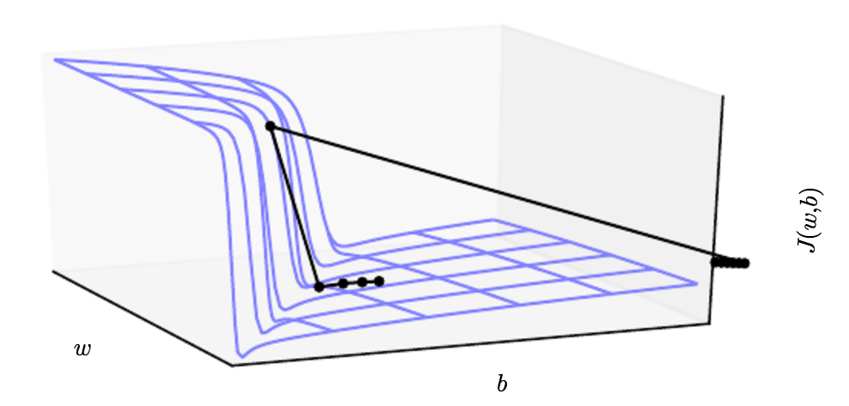
How might we solve this?
Gradient clipping – We decrease the gradients/derivatives if they get too big.
Weight regularisation – We apply a penalty to the loss function for large weight values.
Reduce the learning rate (take smaller steps in gradient descent),

Slide 19
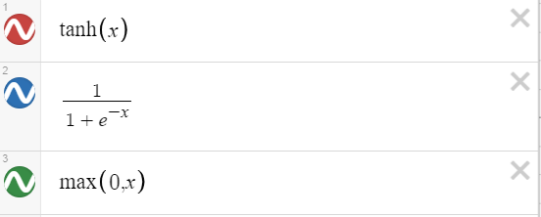
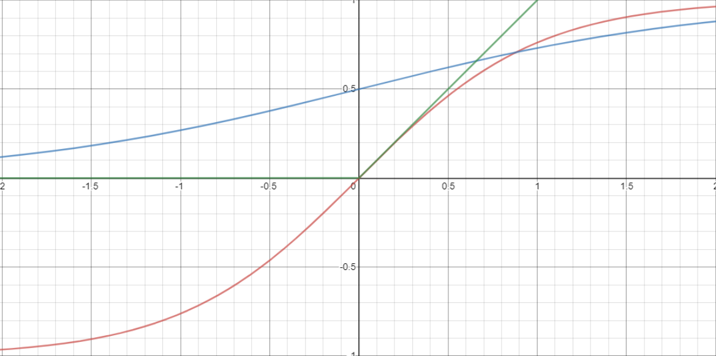
What actually is the activation function, do we have any choice?
Linear!
Yes we do!
The choice of function can be very important and will vary problem to problem
If we didn’t have it, we wouldn’t be learning a non-linear function (see right).
You can have different activation function for different layers in the network
3 common choices:
f(x) = ax +b
g(x) = cx+d
f(g(x)) = acx + (ad + b)
g(f(x)) = cax + (cb + d)
Still linear!

